Slide 1


AWS Cloud Solutions
Presentation
2026
PERSONAL CLOUD DRIVE USING AWS
Secure, Scalable, and Accessible Cloud Storage Solution
Presented by: | Date: | Platform:
Cloud Architecture Team | 2026 | Amazon Web Services

Slide 2

Personal Cloud Drive
AWS Presentation
Page 02
INTRODUCTION
Why Personal Cloud Storage?
The demand for personal cloud storage is growing rapidly. Traditional local storage solutions are limited by hardware capacity, risk of failure, and lack of remote accessibility. AWS provides a robust, scalable, and cost-efficient infrastructure to overcome these challenges and deliver a seamless cloud storage experience.
By leveraging AWS services, users gain secure and reliable access to their files from anywhere, at any time. This solution focuses on three core pillars: security through encryption and IAM policies, accessibility via CloudFront and API Gateway, and cost-efficiency using S3 storage tiers and pay-as-you-go pricing.
aws.amazon.com/cloud-storage

Slide 3

Core Solutions
Presentation
Page 03
PROBLEM STATEMENT
Challenges with Traditional Storage
Traditional local storage solutions are increasingly inadequate for modern needs. Physical hard drives and USB devices offer limited capacity, are prone to hardware failure, and risk permanent data loss. Without redundancy or backup mechanisms, a single device failure can result in the loss of irreplaceable files and critical data.
Existing solutions also lack seamless remote accessibility and real-time synchronization across devices. Users are unable to access their files from anywhere, collaborate efficiently, or maintain consistent data across platforms. Our goal: build a robust personal cloud drive on AWS infrastructure to overcome these limitations.
Powered by Amazon Web Services

Slide 4

Core Solutions
Presentation
Page 04
AWS OVERVIEW
AWS IAM
Secure access control and permissions management. Defines roles and policies to ensure only authorized users can access cloud drive resources.
Amazon S3
Scalable object storage for files and data.
Provides high durability, availability, and virtually unlimited capacity for personal
cloud drive assets.
AWS Lambda
Serverless backend logic and automation. Handles file operations, triggers, and processing without managing infrastructure or servers.
Amazon CloudFront
Content delivery network for fast, global file access. Reduces latency by caching files at edge locations closest to the end user.
www.reallygreatsite.com

Slide 5
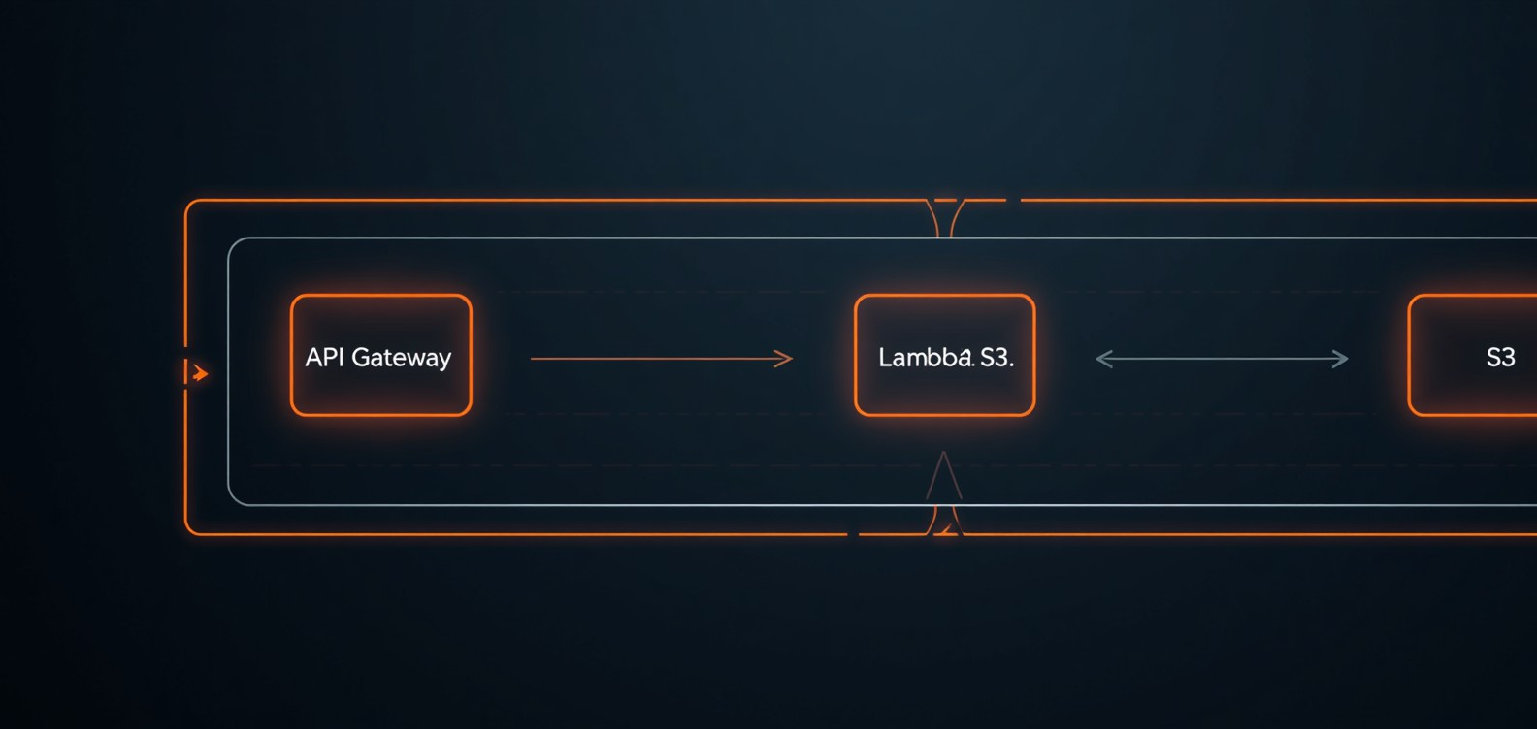
Personal Cloud Drive Using AWS
SYSTEM ARCHITECTURE
User Interface
Mobile and web application serving as the entry point. Users authenticate and interact with the cloud drive via a responsive front-end interface to upload, download, and manage files.
API Gateway
AWS API Gateway routes all incoming HTTP/HTTPS requests from the client to the appropriate backend Lambda functions, providing a secure and scalable request management layer.
S3 & DynamoDB
Amazon S3 stores all user files as scalable object storage. DynamoDB manages file metadata, user records, and versioning data for fast, low-latency lookups and queries.
Lambda Functions
Serverless AWS Lambda functions handle all backend logic including file
operations, authentication validation, metadata updates, and automated
workflows triggered by API calls.
Flow: User → API Gateway → Lambda → S3 / DynamoDB

Slide 6

KEY FEATURES
Personal Cloud Drive
AWS Presentation
File Management
Secure file upload and download via HTTPS. Automatic file versioning ensures previous versions are always recoverable. Files are organized and retrievable instantly from any device.
Scalable Storage
Dynamically scale storage capacity on demand with Amazon S3. Lifecycle policies automate archival to Glacier for cost efficiency. Pay only for the storage you use with no upfront commitment.
Sync & Encryption
Real-time synchronization across all connected devices. AES-256 encryption protects data at rest and in transit. Multi-factor authentication ensures only authorized users gain access.
aws.amazon.com

Slide 7




AWS Cloud Drive
Presentation
Page 07
SECURITY & COMPLIANCE
Security Measure | Status
AWS IAM Roles & Policies | Enabled
S3 AES-256 Encryption | Enabled
HTTPS / TLS Transmission | Enforced
Multi-Factor Authentication | Supported
Security Overview
AWS-powered personal cloud drive enforces enterprise-grade security at every layer. IAM roles restrict access using least-privilege policies, while S3 bucket encryption with AES-256 ensures data is protected at rest. All data in
Compliance Standards
The solution complies with GDPR for data privacy, ISO 27001 for information security management, and SOC 2 for service organization controls — ensuring enterprise-grade trust.
Access Control Model
AWS IAM enforces least-privilege access with role-based policies. Users and services are granted only the permissions required, minimizing attack surface and unauthorized access risk.
transit is secured via HTTPS/TLS. Multi-factor authentication (MFA) adds an extra identity verification layer, and the solution aligns with major compliance frameworks including GDPR, ISO 27001, and SOC 2.
aws.amazon.com

Slide 8



Personal Cloud Drive
AWS Presentation
Page 08
COST OPTIMIZATION
Standard storage cost (USD)
Infrequent Access storage cost (USD)
Glacier storage cost (USD)
$80
$60
$40
AWS Storage Strategy
$20
Optimizing cloud storage costs is essential for a sustainable personal cloud drive. By leveraging AWS S3 storage classes and lifecycle policies, users can significantly reduce expenses while maintaining performance and reliability. The pay-as-you-go model ensures you only pay for what you use.
$0
Jan 1, 2026
Feb 1, 2026 Mar 1, 2026 Apr 1, 2026
Source: AI-generated data. Replace or verify before use.
May 1, 2026
Jun 1, 2026
Cost Savings by Storage Class
S3 Standard for frequently accessed files
Lifecycle policies automate archival
S3 Infrequent Access & Glacier for cold data
Pay-as-you-go: zero upfront cost
www.yourcloudsite.com

Slide 9

Personal Cloud Drive Using AWS
IMPLEMENTATION STEPS
Step 1 & 2
Set up AWS account with billing and security preferences. Configure IAM roles and policies to enforce least-privilege access control for all services and users.
Step 3 & 4
Create and configure S3 buckets with versioning and encryption enabled. Develop Lambda functions to handle file upload, download, and metadata operations.
Step 5
Build and integrate API Gateway endpoints to route client requests to Lambda functions. Enable CORS, authentication, and throttling for secure and reliable access.
Step 6
Develop the front-end web or mobile interface for file management. Conduct end-to-end testing, resolve issues, and deploy the full system to production on AWS.
aws.amazon.com

Slide 10

USE CASES
Personal Cloud Drive Using AWS
Presentation
File Backup & Sharing
Automatically back up personal files to Amazon S3 with versioning enabled. Share files securely with others via pre-signed URLs, ensuring controlled access without exposing sensitive data or credentials.
Photo & Video Storage
Store and stream high-resolution photos and videos using S3 and CloudFront CDN. Enjoy fast, low-latency access to media from any device, anywhere in the world, with scalable capacity on demand.
Document Sync & Archiving
Sync documents seamlessly across multiple devices in real time. Professionals can leverage AWS Glacier for secure, cost-effective long-term archiving with compliance-ready encryption and audit logging.
www.reallygreatsite.com

Slide 11
Personal Cloud Drive
AWS Presentation
Page 11
BENEFITS SUMMARY
Core Benefits
AWS-powered cloud drive delivers scalability, high availability, and automated workflows. Users gain seamless access, robust encryption, and cost-efficient storage — while businesses eliminate infrastructure overhead and scale flexibly on demand.
Category | Key Benefits
Technical | Scalability & Automation
User | Easy Access & Security
Business | Reduced Overhead
Operational | Flexible Scaling
Why It Matters
By leveraging AWS services, organizations and individuals achieve enterprise-grade reliability without upfront capital investment. The solution adapts to growing needs while maintaining security and compliance at every layer.
aws.amazon.com/solutions

Slide 12

Personal Cloud Drive Using AWS
Presentation
12
CONCLUSION
Conclusion & Next Steps
The AWS-based Personal Cloud Drive delivers a secure, scalable, and cost-efficient storage solution. Leveraging S3, Lambda, IAM, and CloudFront, it provides seamless file access, automatic versioning, and enterprise-grade encryption — all on a flexible pay-as-you-go model.
Next Steps:
Prototype development and architecture setup
User testing and performance benchmarking
Full deployment and CI/CD integration
Continuous optimization and cost monitoring
By continuing to innovate, adapt, and focus on customer value, the company is well-positioned for long-term success.
aws.amazon.com/solutions

